Slide 1
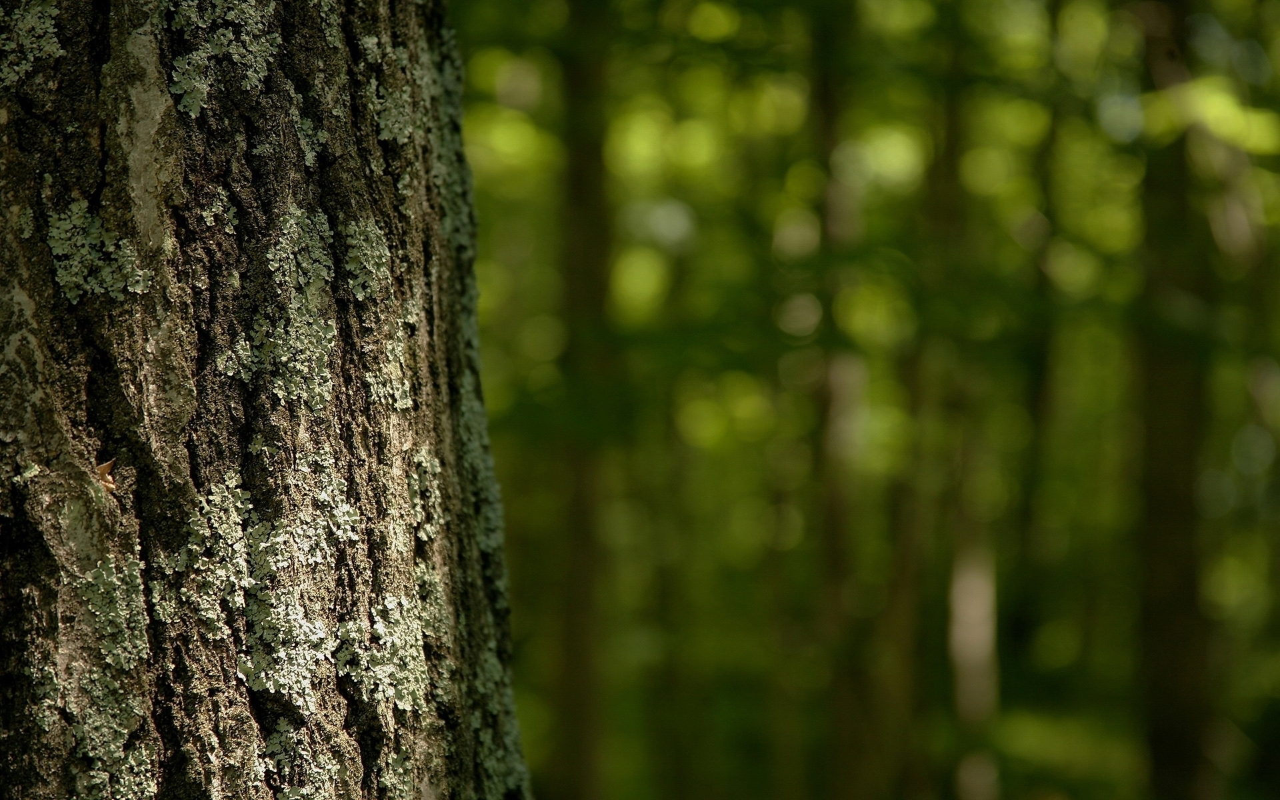

TreeCare
Team Name: SP
Team Mates: Priyanka Madekar
Sakshi Shinde

Slide 2
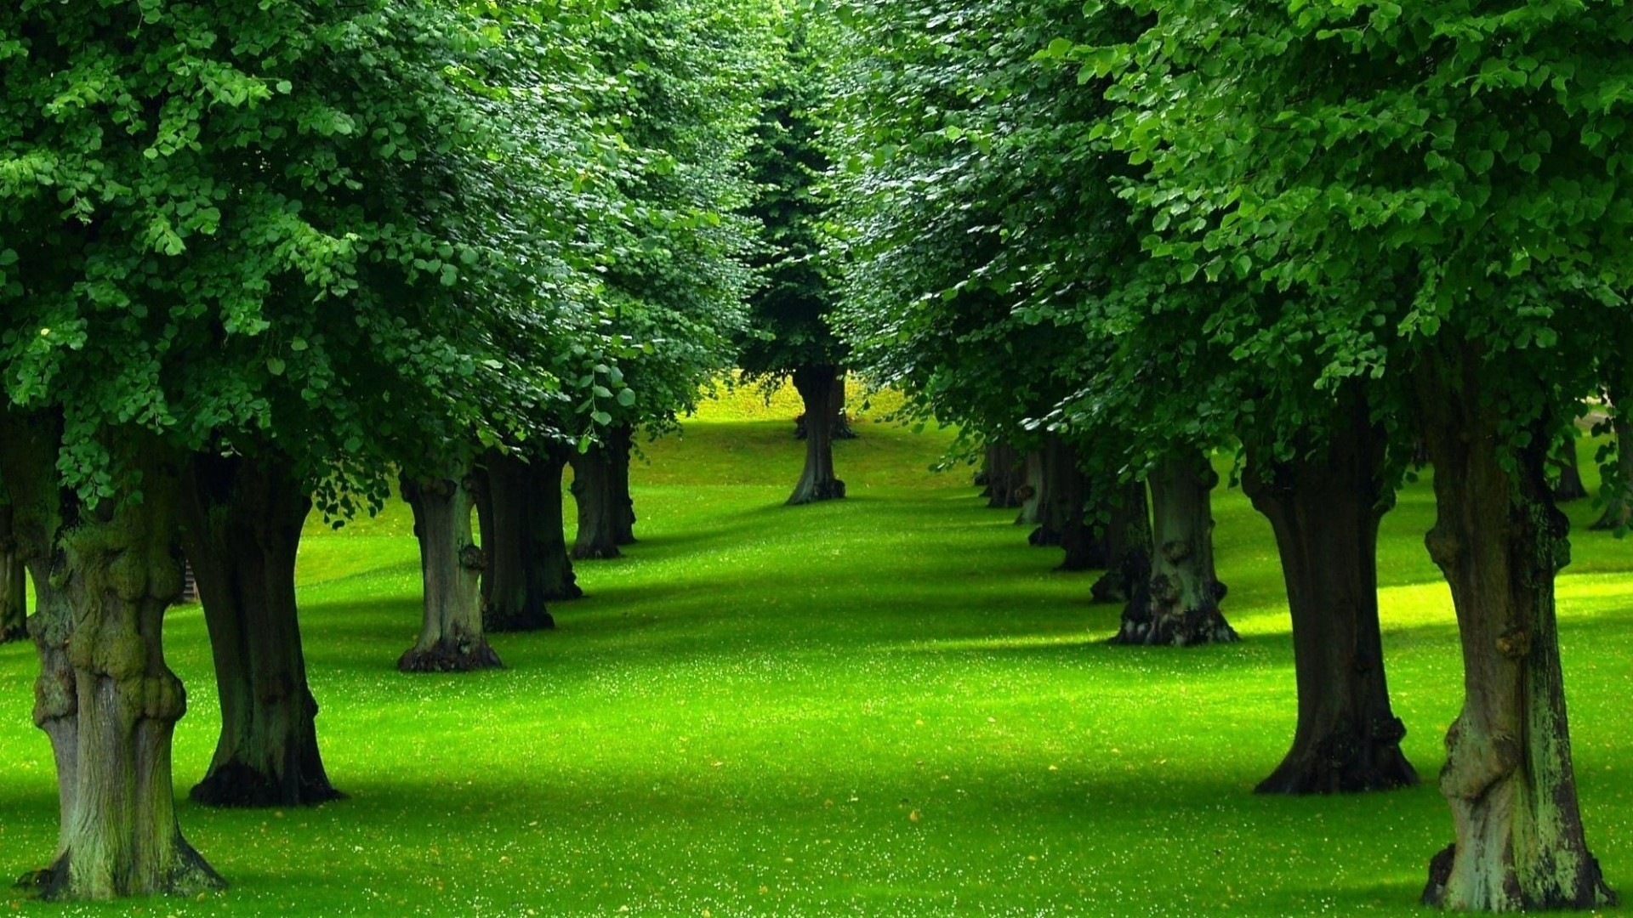
Problem Statement
This open innovation challenge invites individuals, teams, and organizations to contribute their innovative ideas, projects, and initiatives aimed at mitigating and adapting to climate change. The challenge is intentionally open-ended, allowing participants to explore diverse approaches and ideas to combat climate change.

Slide 3
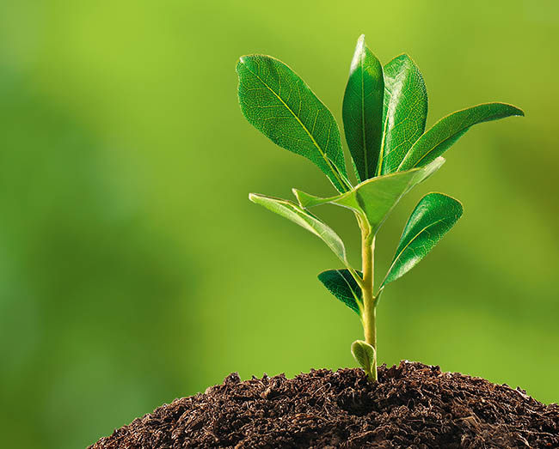
Our Idea
We are making an app where in by simply scanning a tree, users will gain instant access to crucial details such as the tree’s compatibility with different climates, nutritional requirements and precise water level needs.
Moreover, the app will utilize cutting-edge sensors to autonomously adjust watering schedules, ensuring that trees receive the ideal amount of hydration based on seasonal changes.
This all-encompassing tool will not only promote tree care but also contribute to environmental conservation and sustainable landscaping practices.

Slide 4
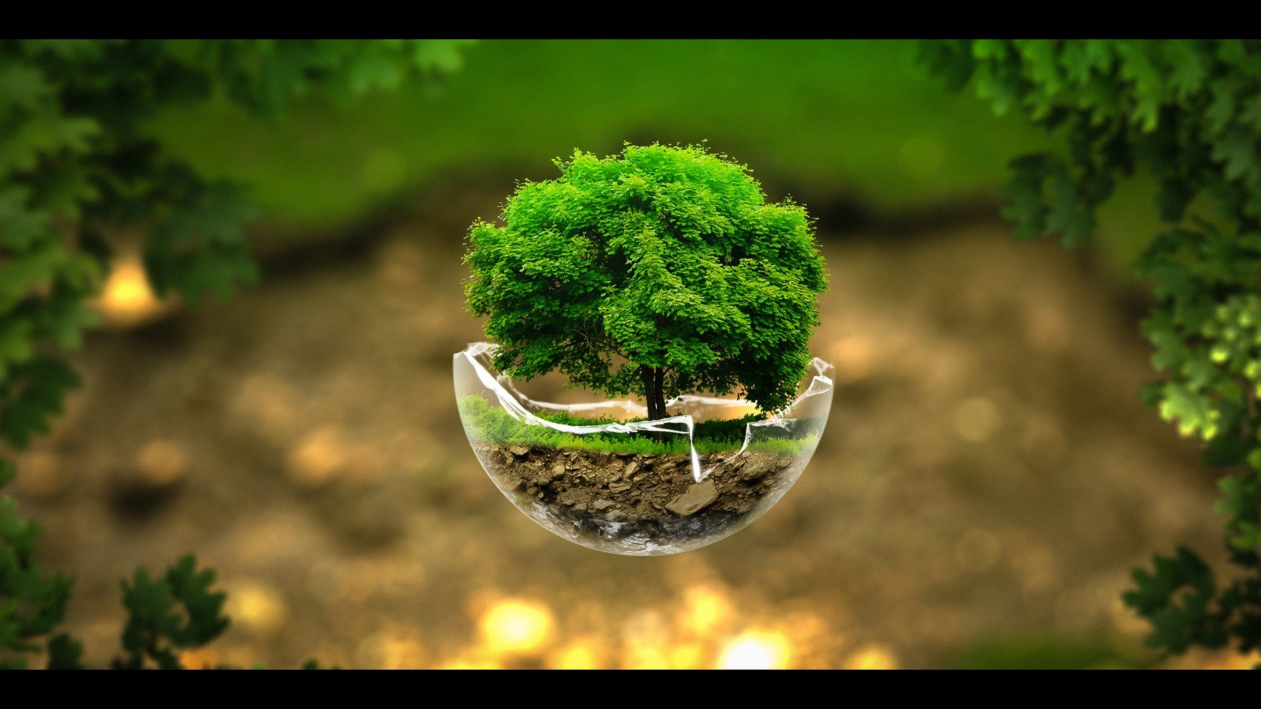
How it Works
Tree Identification: Simply point your smartphone at a tree, take a photo of its leaves or bark, and let TreeCare work its magic. Our powerful image recognition technology will identify the tree species instantly.
Climate and Nutrient Analysis: Once identified, TreeCare provides you with valuable insights into the tree's preferred climate conditions and nutrient requirements including watering schedule.
Disease Detection: Tree health is a top priority. TreeCare scans for common tree diseases by analyzing the tree's visual characteristics. If any issues are detected, the app will alert you, providing a detailed description of the problem.
Solutions and Care Tips: Not only does TreeCare diagnose tree issues, but it also offers practical solutions and care tips. You'll receive step-by-step instructions on how to address diseases, improve soil quality, and even suggest suitable companion plants to enhance your tree's growth.

Slide 5
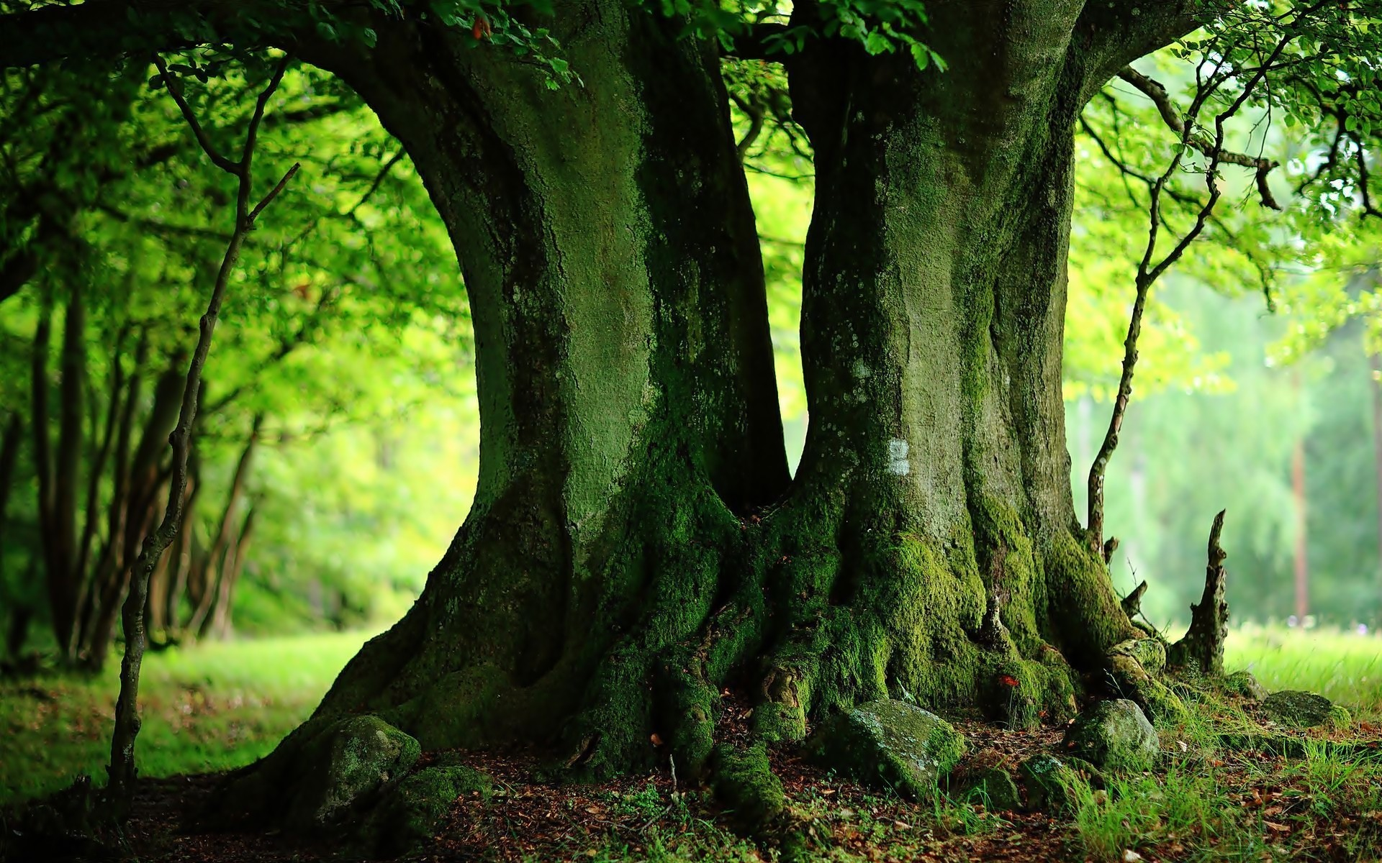
Key Features
Extensive Tree Database: Access a comprehensive database of tree species, complete with detailed information on each one.
Personalized Recommendations: TreeCare learns about your local climate and soil conditions, providing tailored advice for your specific region.
Community Support: Connect with fellow tree enthusiasts through TreeCare's community forums to share experiences and seek advice.
Notifications: Receive timely alerts about your tree's care routine, including watering reminders and seasonal maintenance tips.

Slide 6
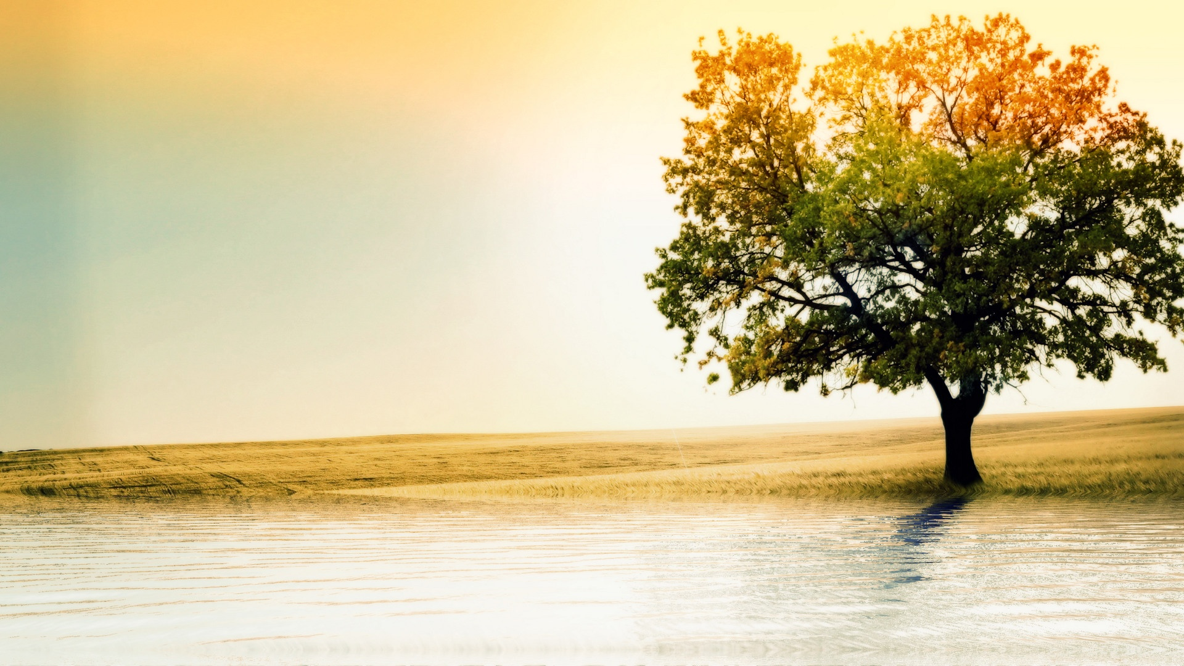
Why TreeCare?
Promoting Environmental Awareness: TreeCare encourages people to connect with nature, fostering a sense of responsibility for the environment.
Tree Health Preservation: By diagnosing and treating tree diseases early, TreeCare helps save trees and maintain the green beauty of our planet.
Educational Tool: TreeCare serves as an educational resource for schools, students, and anyone interested in understanding the world of trees.

Slide 7
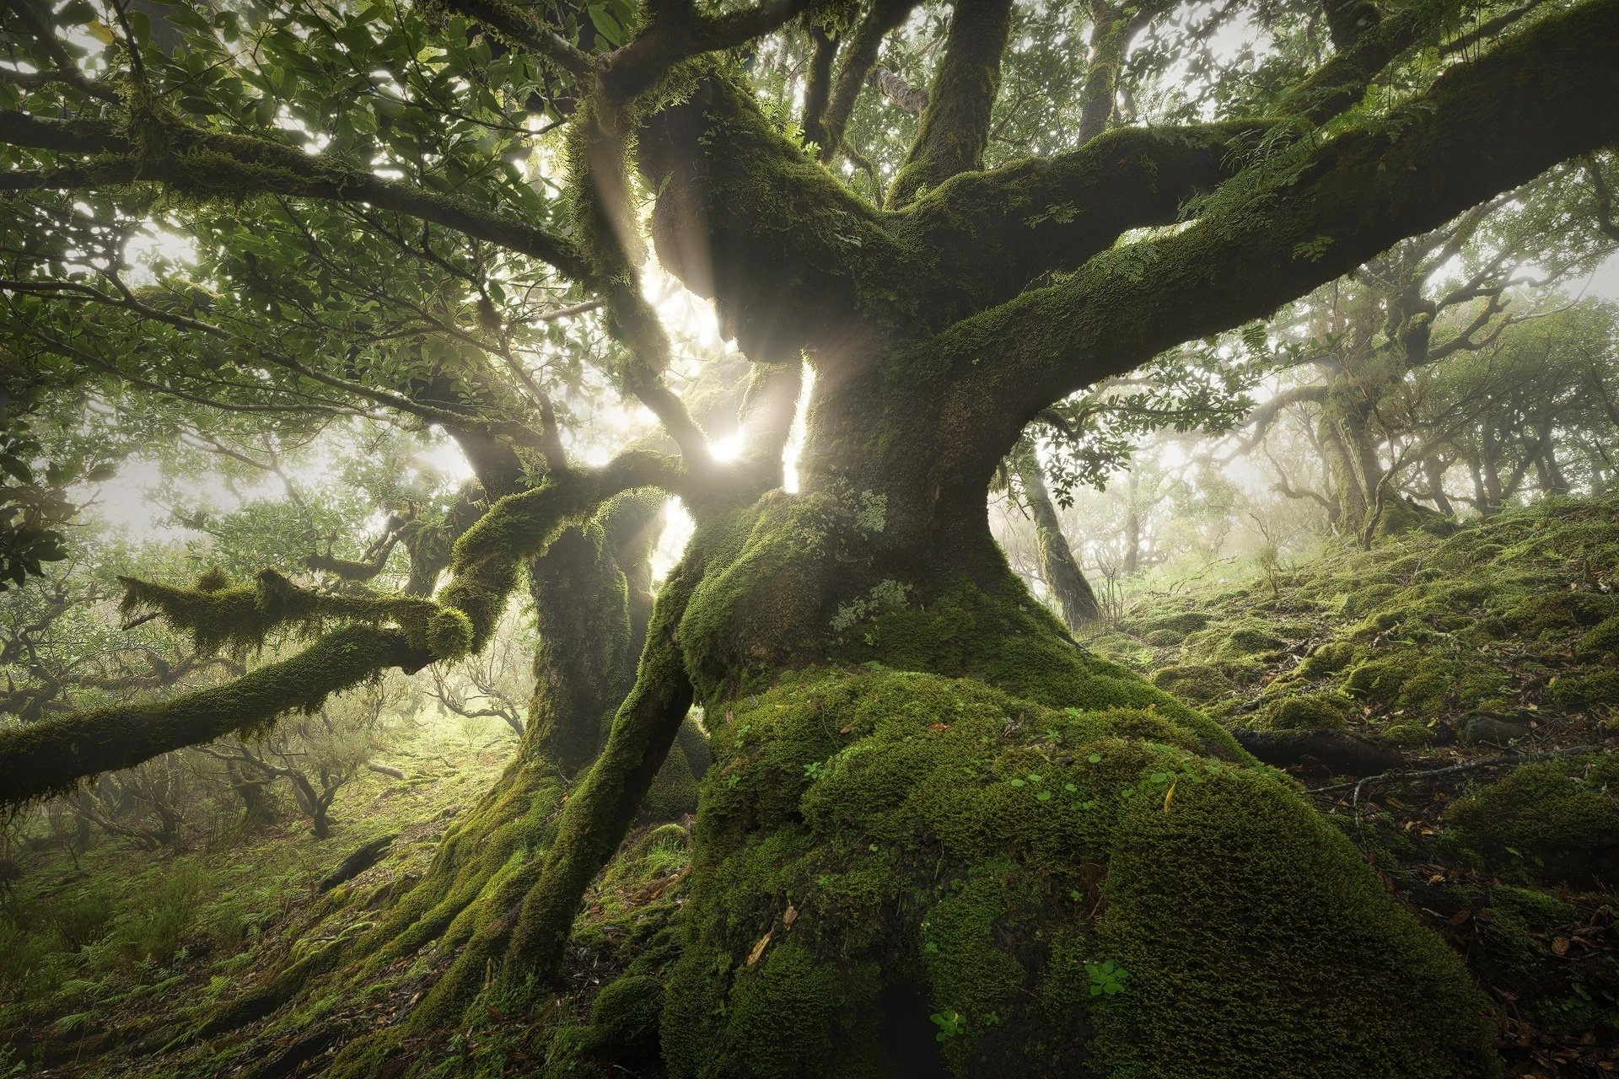
Join us in nurturing our planet, one tree at a time, with TreeCare: Your Tree Care Companion.

